Slide 1
Estimating the global satellite-derived surface NH3 concentration
Zhenqi Luo 2020.11

Slide 2
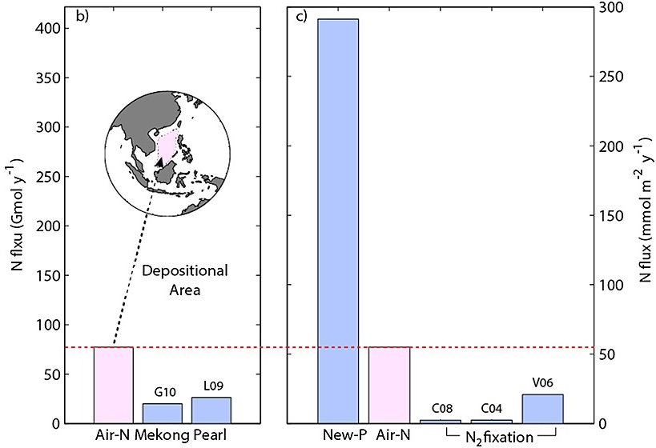
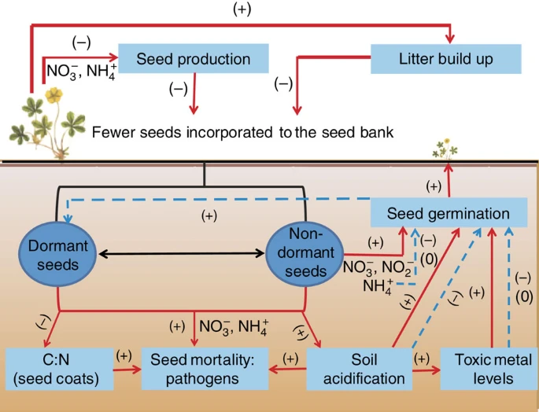
Estimation of surface NH3 concentration
Important in modelling the dry deposition of NH3
Soil acidification
Aquatic ecosystem eutrophication
Drinking water contamination
Form ammonium salt——particulate matters (PM)
Air quality
Human health
National monitoring programs: 2014
NNDMN (2014~): China
AMoN-China (2015~)
AMoN-US: US
EMEP: Europe
Satellite instruments
IASI: 2008-2016
daytime (09:30)
processed into 0.25°×0.25° (arithmetic averaging method)
AIRS
CrIS
TES
Chemistry transport models (CTMs)——GEOS-Chem (vertical profile and monthly averages): 2014
Daily average and 9-10am average
2°×2.5°×47level
Meteorological filed data: GEOS-FP
Emissions: EDGAR
East Asia: MIX
Europe: EMEP
US: NEI
Canada: CAC
Biomass burning: FINNv1 (agricultural fires, wildfire and pre-scribed burning)
Atmospheric N deposition to the South China Sea
soil seed bank depletion by N pollution
(Kim et al., 2014)
(Basto et al., 2015)
Notes:
Used the daytime IASI NH3 measurements due to the larger positive thermal contrast detected by satellite instruments leading to smaller errors compared to the nighttime data (Van Damme et al., 2014b).
The IASI NH3 columns used in this study were processed into the monthly data at 0.25° latitude × 0.25° longitude grids by the arithmetic averaging method (Van Damme et al., 2017;Whitburn et al., 2016;Liu et al., 2017a).

Slide 3
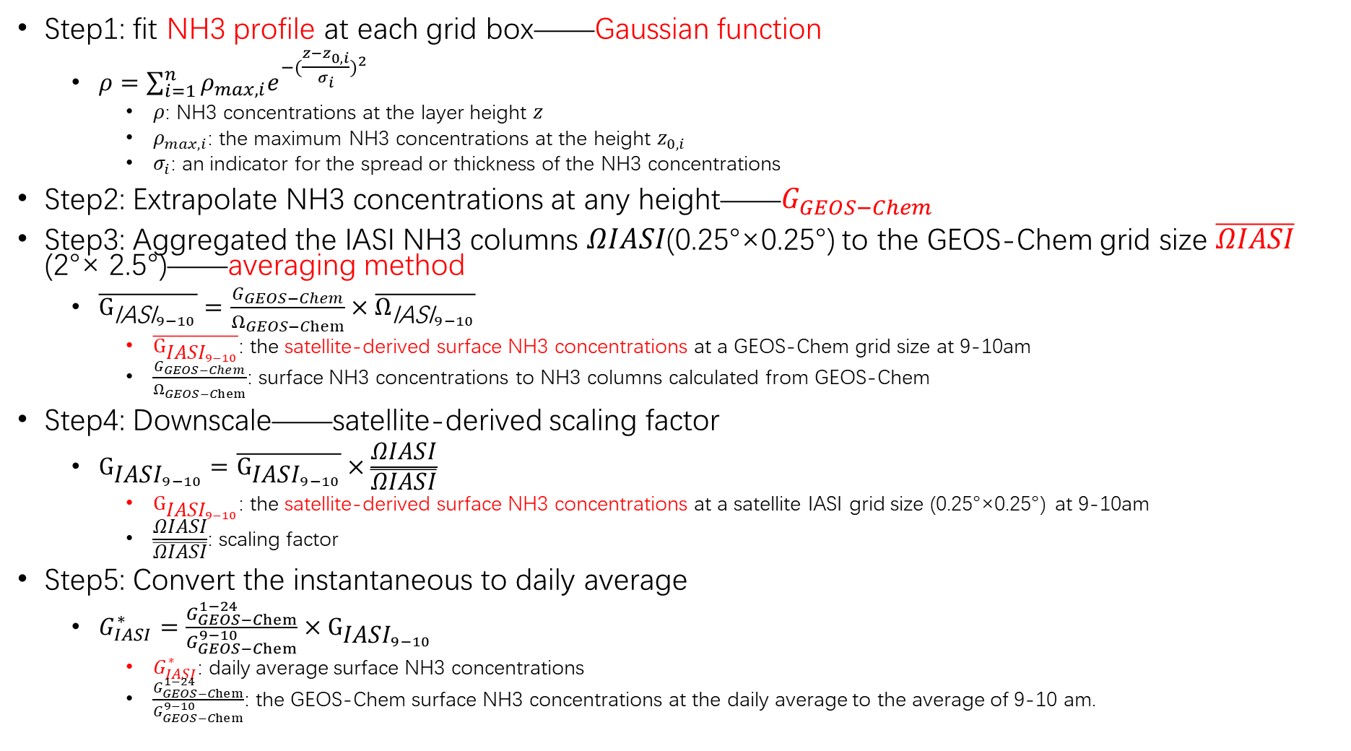
Estimation of surface NH3 concentration
Step1: fit NH3 profile at each grid box——Gaussian function
$ρ=\sum_{i=1}^{n}{ρ_{max,i}e^{−{(\frac{z−z_{0,i}}{σ_{i}})}^{2}}}$
$ρ$: NH3 concentrations at the layer height $z$
$ρ_{max,i}$: the maximum NH3 concentrations at the height $z_{0,i}$
$σ_{i}$: an indicator for the spread or thickness of the NH3 concentrations
Step2: Extrapolate NH3 concentrations at any height——$G_{GEOS−Chem}$
Step3: Aggregated the IASI NH3 columns 𝛺𝐼𝐴𝑆𝐼(0.25°×0.25°) to the GEOS-Chem grid size $\overline{\text{Ω}\text{IASI}}$ (2°× 2.5°)——averaging method
$\overline{{\text{G}}_{{\text{IASI}}_{9−10}}}=\frac{G_{GEOS−Chem}}{Ω_{GEOS−Chem}}×\overline{Ω_{{\text{IASI}}_{9−10}}}$
$\overline{{\text{G}}_{{\text{IASI}}_{9−10}}}$: the satellite-derived surface NH3 concentrations at a GEOS-Chem grid size at 9-10am
$\frac{G_{GEOS−Chem}}{Ω_{GEOS−Chem}}$: surface NH3 concentrations to NH3 columns calculated from GEOS-Chem
Step4: Downscale——satellite-derived scaling factor
${\text{G}}_{{\text{IASI}}_{9−10}}=\overline{{\text{G}}_{{\text{IASI}}_{9−10}}}×\frac{\text{Ω}\text{IASI}}{\overline{\text{Ω}\text{IASI}}}$
${\text{G}}_{{\text{IASI}}_{9−10}}$: the satellite-derived surface NH3 concentrations at a satellite IASI grid size (0.25°×0.25°) at 9-10am
$\frac{\text{Ω}\text{IASI}}{\overline{\text{Ω}\text{IASI}}}$: scaling factor
Step5: Convert the instantaneous to daily average
$G_{IASI}^{∗}=\frac{G_{GEOS−Chem}^{1−24}}{G_{GEOS−Chem}^{9−10}}×{\text{G}}_{{\text{IASI}}_{9−10}}$
$G_{IASI}^{∗}$: daily average surface NH3 concentrations
$\frac{G_{GEOS−Chem}^{1−24}}{G_{GEOS−Chem}^{9−10}}$: the GEOS-Chem surface NH3 concentrations at the daily average to the average of 9-10 am.

Slide 4
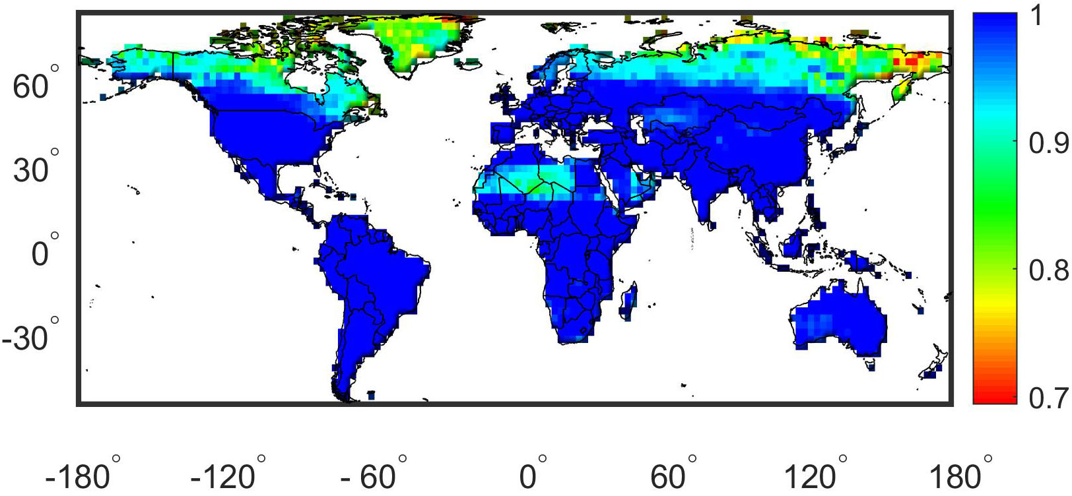
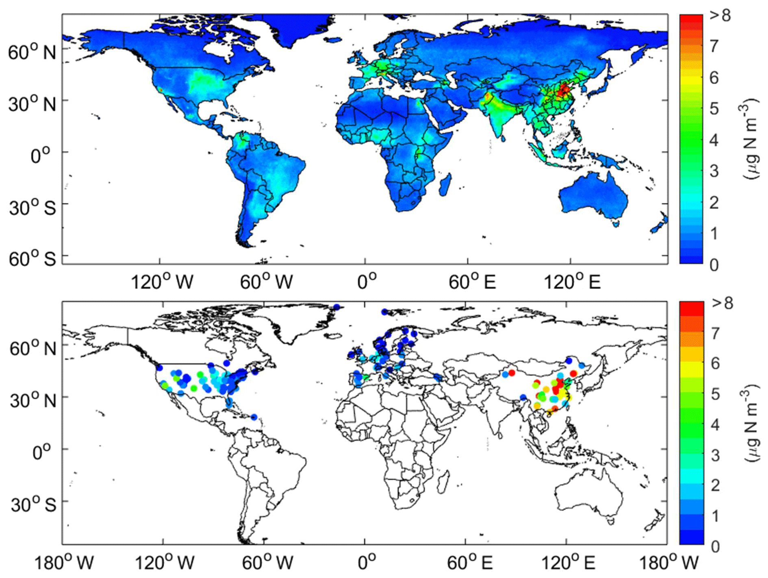
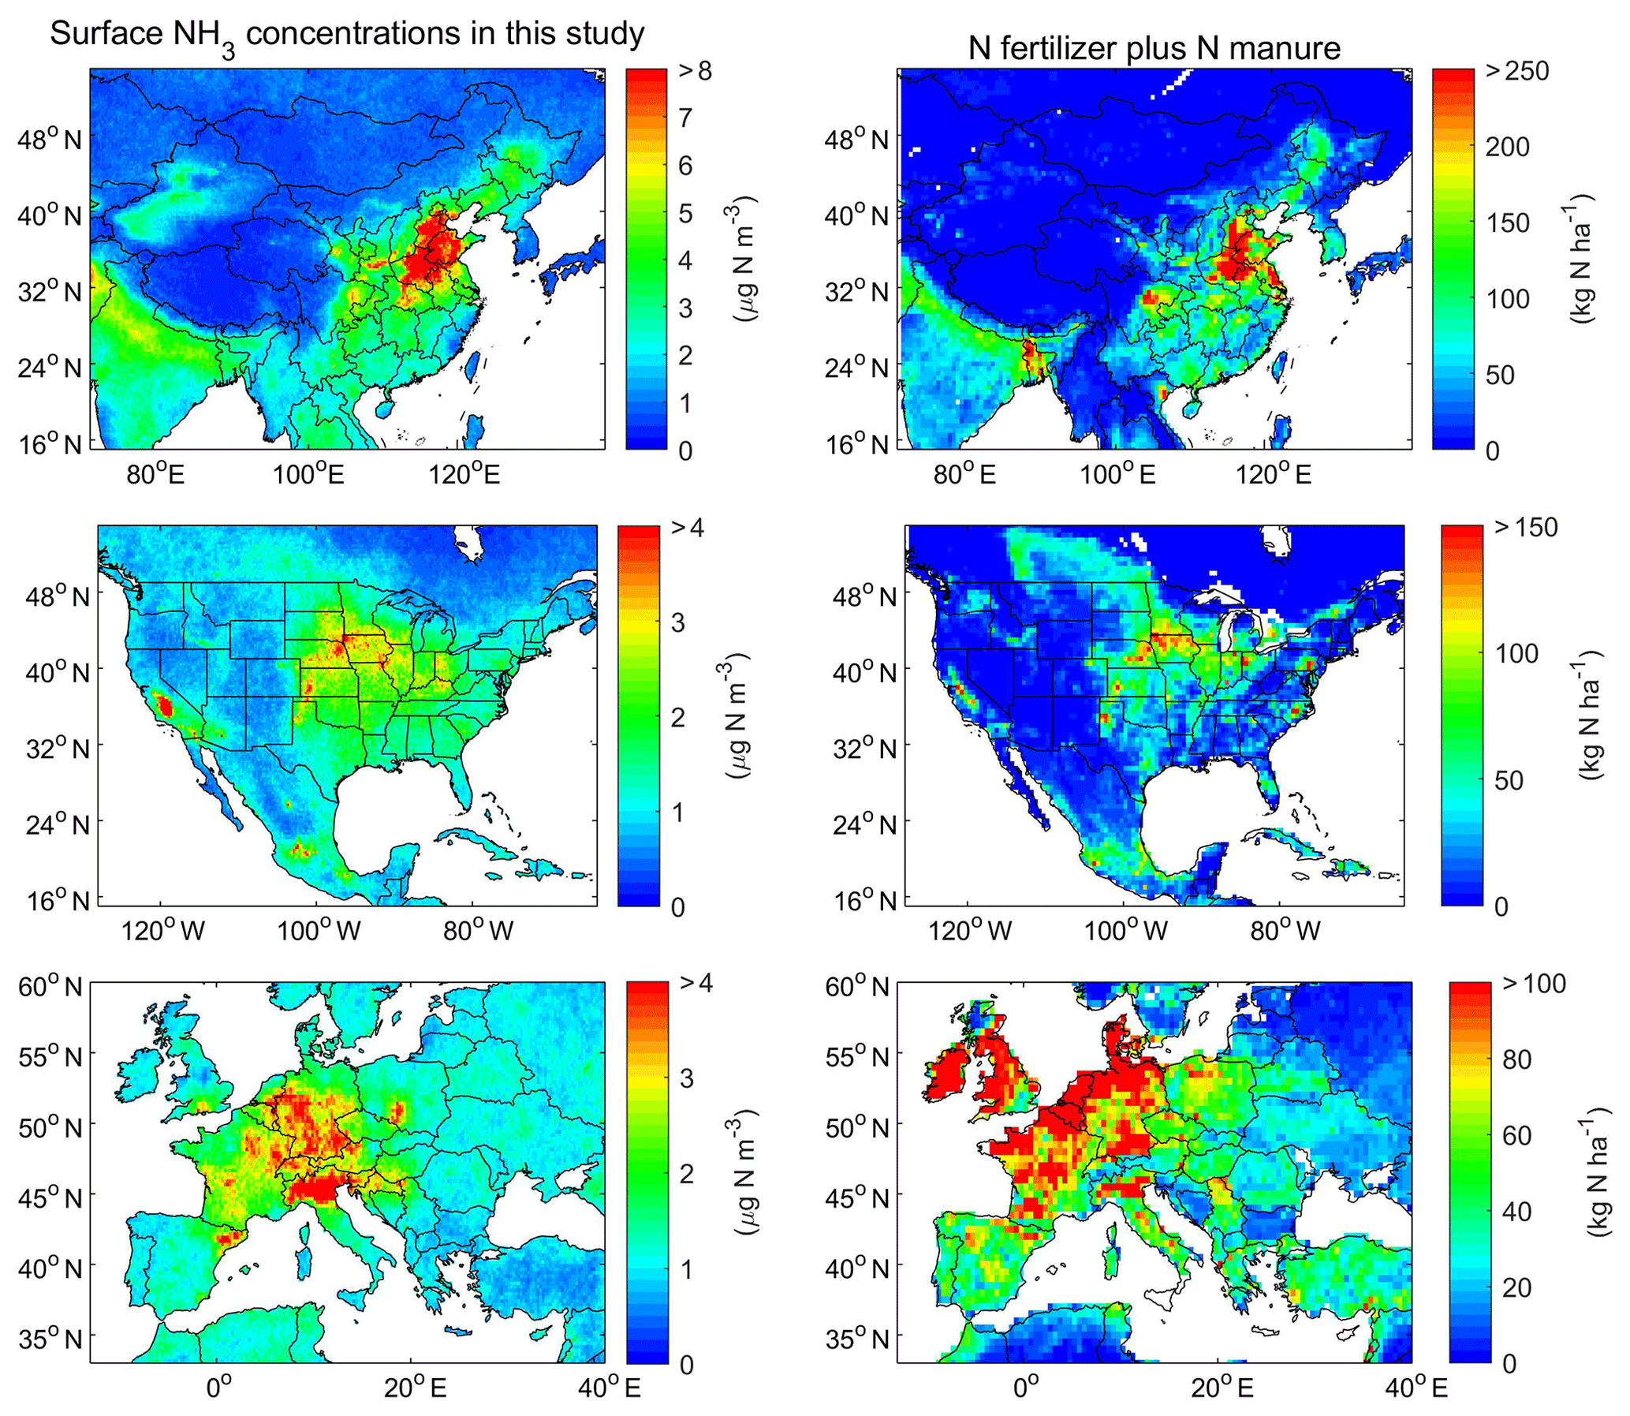
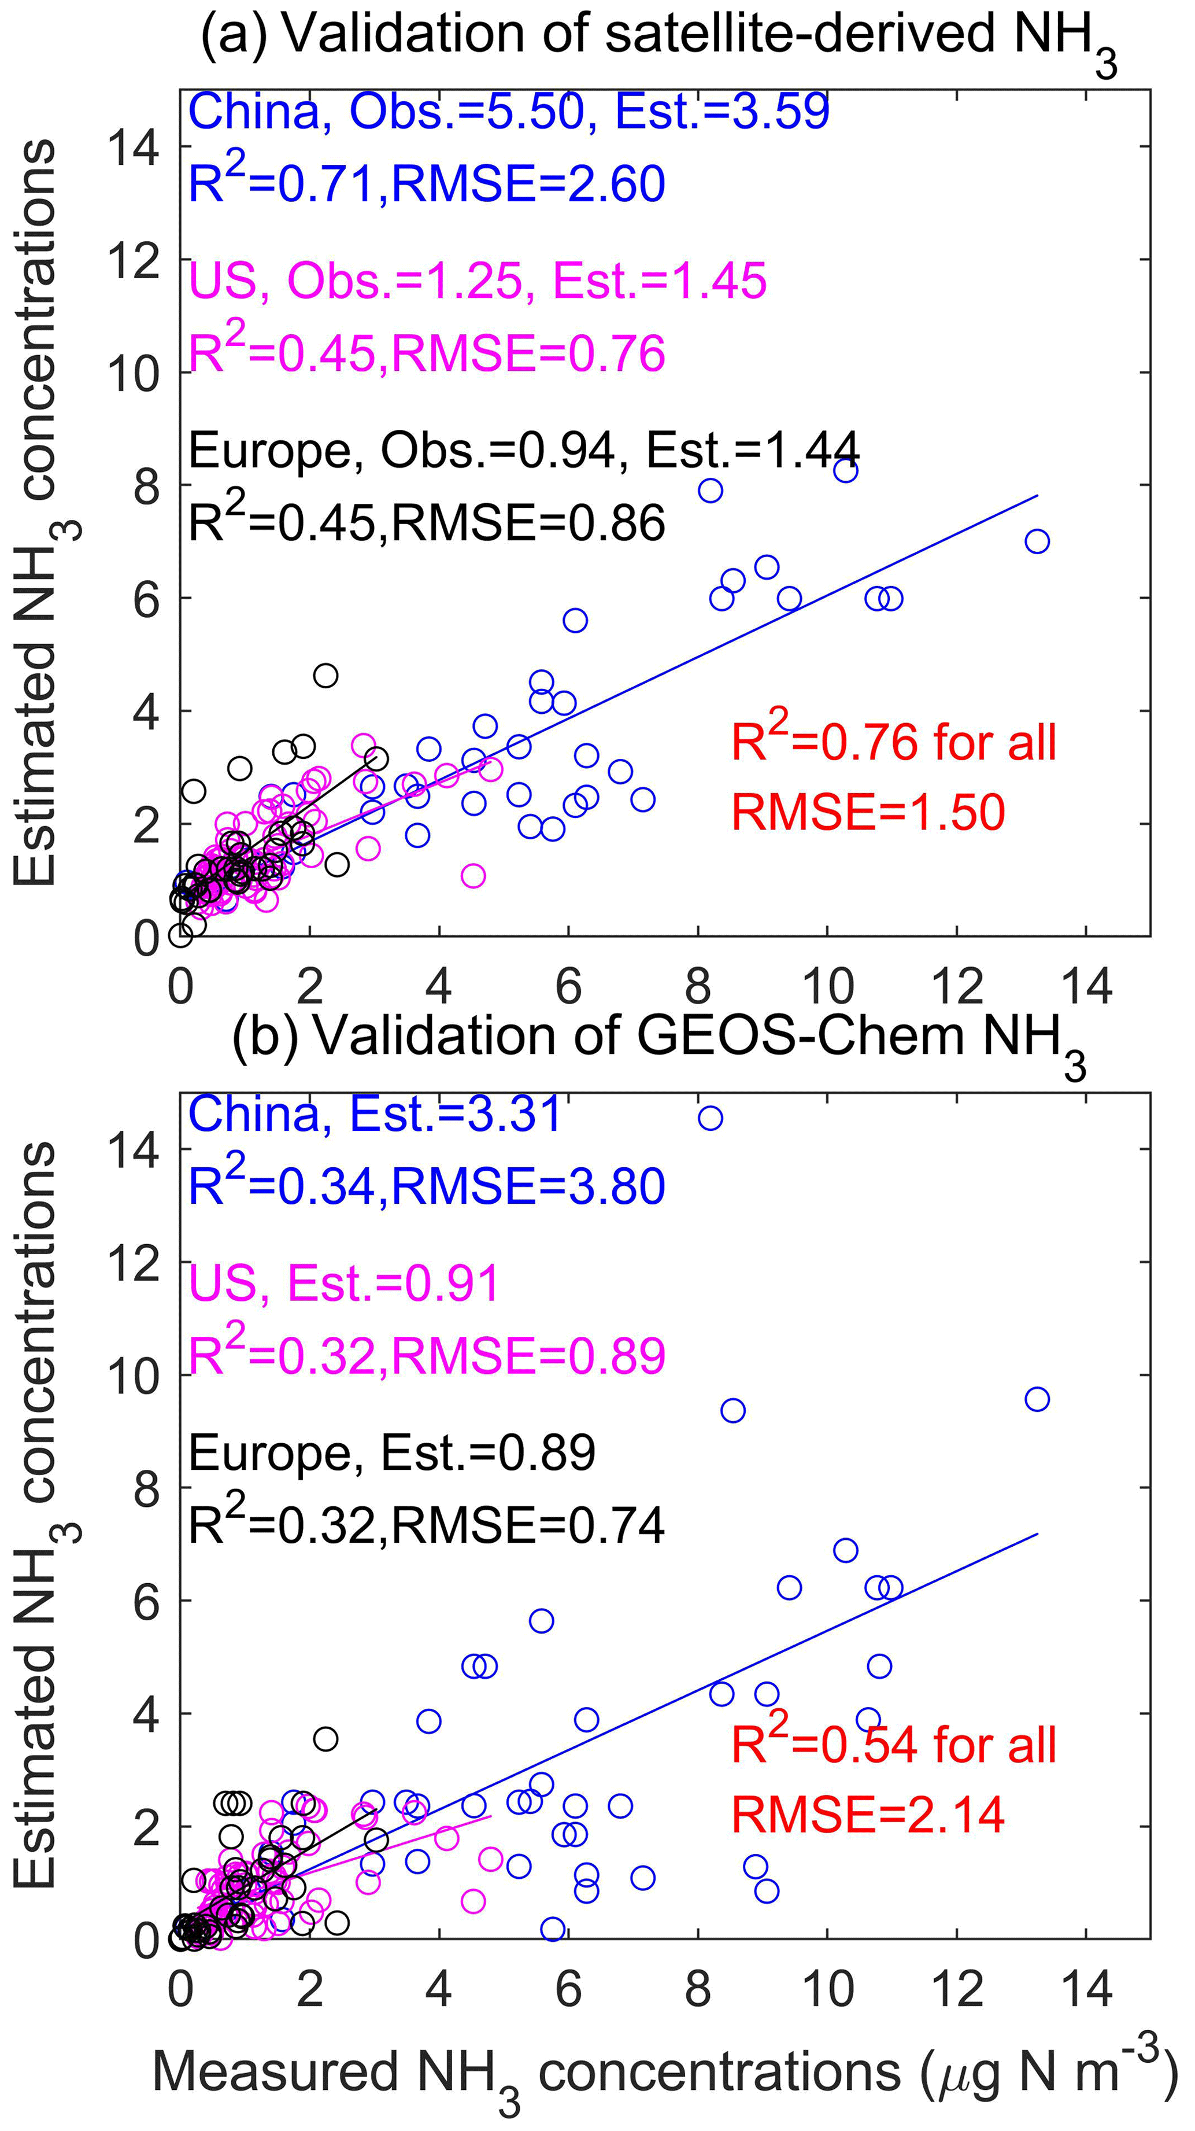
Results——satellite-derived surface NH3
NH3 vertical profiles from GEOS-Chem
60°N and 55°S can be well modelled
Validation
capture the general spatial pattern fairly well
IASI-derived surface NH3 concentrations had better consistency than GEOS-Chem
China
the US
Europe
Spatial distributions
China——croplands (R²=0.65)
eastern China
Sichuan Basin
northwestern Xinjiang
US——croplands, livestock (SJV) (R²=0.30)
Central US
Eastern US
Western coastal
Europe——croplands (R²=0.17)
Western
(Liu et al., 2019)

Slide 5
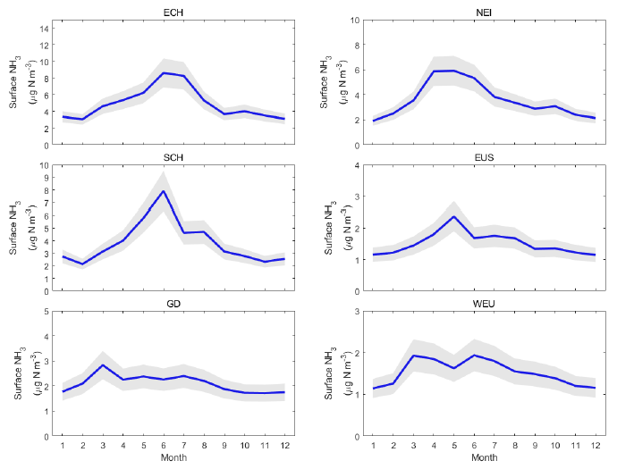
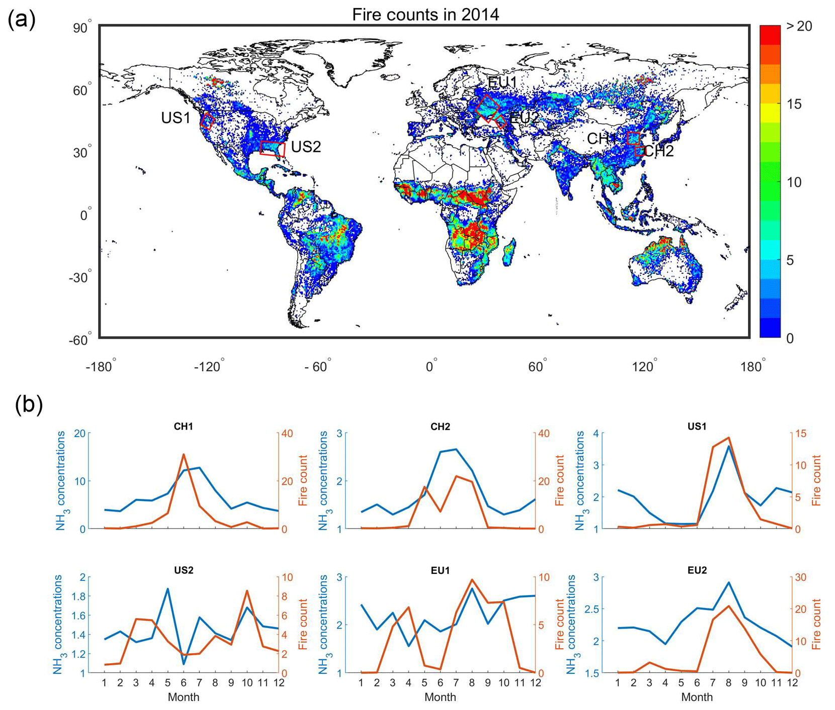
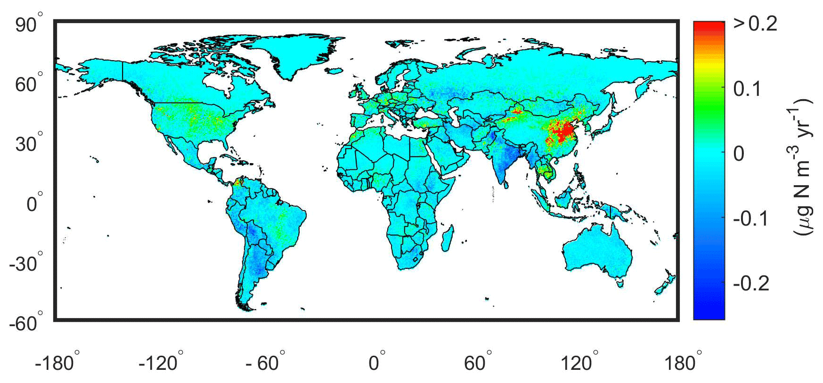
Results——satellite-derived surface NH3
(Liu et al., 2019)
Seasonal variations
China (ECH/SCH/GD)——Spring and summer (3-8)
N fertilizer/manure application
temperature in warm months
Eastern US (EUS)——3-8, maximum in 5
higher temperature
emissions in vast croplands
Western Europe——3-6
higher temperature
frequent N fertilization
the relationship with biomass burning
CH1: crop straw burning
CH2: the wetter climate and more frequent precipitation events
US1: the forest fires or anthropogenic biomass burning
US2: potential mineral N fertilization and anthropogenic biomass burning or forest fires
EU1: the biomass burning and the agricultural fertilizations
EU2: the biomass burning
Trends

Slide 6
Questions?

